Slide 1





ResumeRover
Team : Priya Pratheesh, priyapratheesh712@gmail.com
Guide : Saomya Chaudhury
Disclaimer: The content is curated for educational purposes only.
Notes:
Slides: Prepare a short slide deck (10-12 slides) summarizing the project objectives, methodology, and key results.

Slide 2
OUTLINE
Abstract of the Project
Problem Statement
Proposed Solution
System Architecture
Live Demo of the Project
Embedded Video of Project
Conclusion
Future Scope

Slide 3
Problem Statement
The recruitment process faces significant inefficiencies due to manual resume screening and candidate-job matching. HR professionals and hiring managers spend excessive time reviewing unstructured resume data, leading to:
Inconsistent evaluation of candidates across different resume formats and styles
High time-to-hire metrics that delay critical business operations
Subjective screening that may introduce unconscious bias in candidate selection
Difficulty in extracting and standardizing key qualification indicators from diverse resume structures
Limited ability to perform quantitative analysis on candidate pools at scale
Suboptimal matching between job requirements and candidate qualifications
ResumeRover addresses these challenges by automating resume parsing, standardizing candidate data, implementing objective matching algorithms, and providing analytical insights to streamline the recruitment process, reduce time-to-hire, and improve the quality of candidate selection.

Slide 4
Abstract
In the contemporary recruitment landscape, organizations face the challenge of efficiently processing vast numbers of job applications while mitigating inherent biases in candidate selection. This project introduces an AI-powered resume screening system designed to automate the evaluation process, ensuring a fair and efficient assessment of applicants. Leveraging Natural Language Processing (NLP) and Machine Learning (ML) techniques, the system extracts and analyzes key information from resumes, aligning candidate qualifications with job requirements. By implementing this automated approach, the system not only accelerates the hiring process but also enhances the accuracy of candidate-job matching, thereby reducing the workload on human recruiters and promoting unbiased hiring practices.

Slide 5
Proposed Solution
Resume Parsing & Feature Extraction
Converts resumes into structured data using NLP techniques.
Extracts key details like name, contact information, skills, experience, and education.
Job Description Processing
Analyzes job postings using NLP to extract required skills, experience, and qualifications.
Candidate-Job Matching & Scoring
Uses ML algorithms to compute similarity scores between resumes and job descriptions.
Assigns weighted scores to factors like skills, experience, and certifications.
Ranking & Shortlisting
Generates a ranked list of candidates based on matching scores.
Flags top candidates for recruiter review.
User-Friendly Interface
Provides an interactive dashboard for recruiters to view ranked candidates.

Slide 6
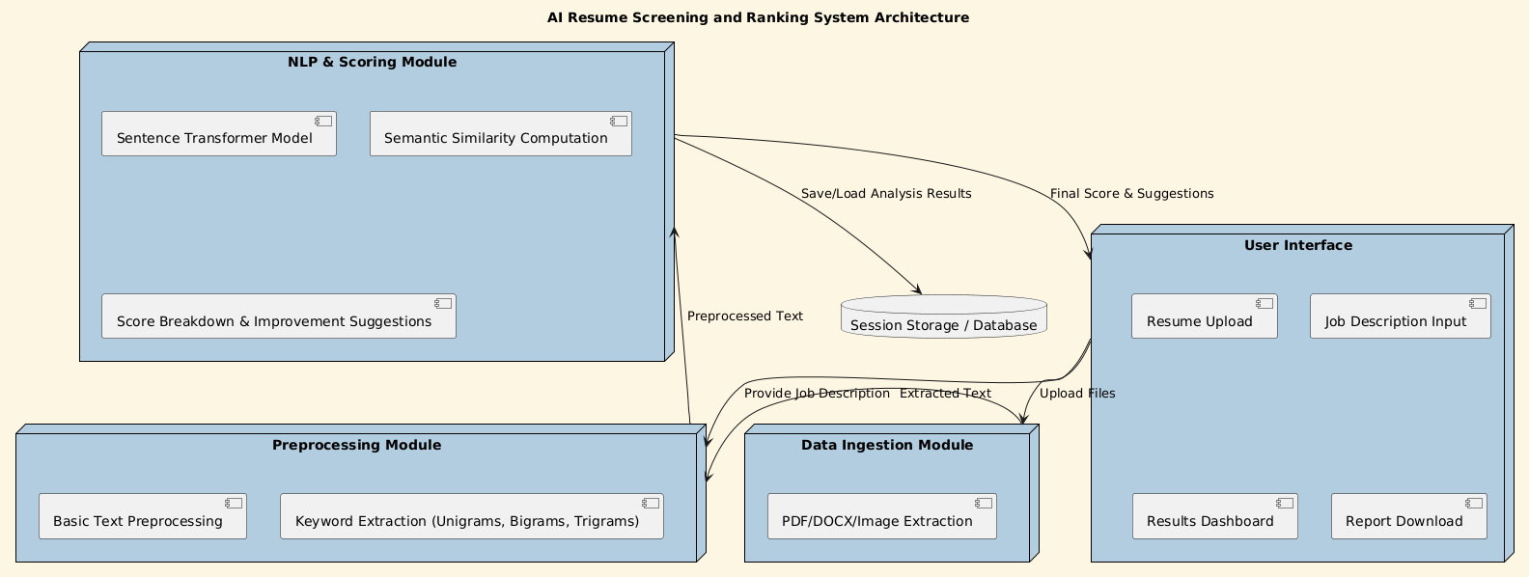
System Architecture

Slide 7
Live Demo of Project
https://github.com/PriPrat4674/ResumeRover/

Slide 8
Conclusion
The AI-powered resume screening system enhances the hiring process by automating candidate evaluation, reducing human bias, and improving efficiency. By leveraging NLP and ML, the system ensures that recruiters can quickly and fairly identify top candidates based on job-specific criteria. This project demonstrates how AI can streamline recruitment, saving both time and resources while maintaining accuracy and fairness in hiring decisions.

Slide 9
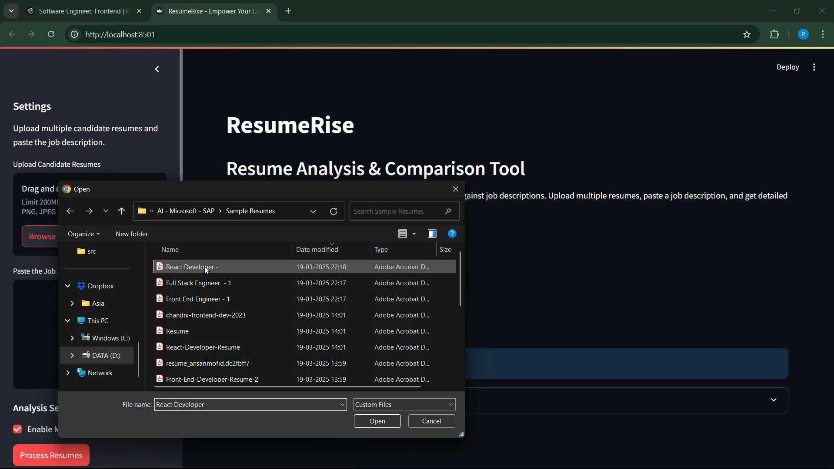
Video of Project Demo

Slide 10
Future Scope
Future improvements could include refining the ranking algorithm to incorporate more advanced AI models, such as deep learning for better semantic understanding. Expanding the system to support multilingual resumes and integrating it with applicant tracking systems (ATS) would further enhance its usability. Additionally, incorporating feedback loops from recruiters and candidates can help continuously improve its accuracy and effectiveness.

Slide 11
Thank you!
Notes:
thank you very much for joining this PPT, keep learning.
11

